Slide 1
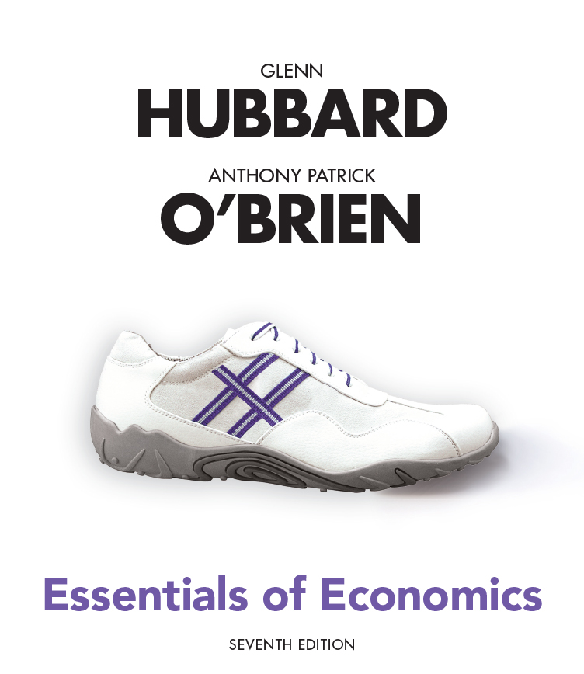
Essentials of Economics
Seventh Edition
Chapter 2
Trade-offs, Comparative Advantage, and the Market System
Copyright © 2021, 2019, 2017 Pearson Education, Inc. All Rights Reserved.
Notes:
If this PowerPoint presentation contains mathematical equations, you may need to check that your computer has the following installed:
1) MathType Plugin
2) Math Player (free versions available)
3) NVDA Reader (free versions available)

Slide 2
Chapter Outline
2.1 Production Possibilities Frontiers and Opportunity Costs
2.2 Comparative Advantage and Trade
2.3 The Market System

Slide 3
Scarcity and Trade-offs
Households, firms and governments continually face decisions about how best to use their scarce resources.
Scarcity: a situation in which unlimited wants exceed the limited resources available to fulfill those wants.
Scarcity requires trade-offs. Economics teaches us tools to help make good trade-offs.
Example: When deciding how to use its scarce workers and machinery, if Tesla wants to produce more Model 3s, those resources will not be available to produce Model Ss.

Slide 4
2.1 Production Possibilities Frontiers and Opportunity Costs
Use a production possibilities frontier to analyze opportunity costs and trade-offs.
A production possibilities frontier (PPF) is a curve showing the maximum attainable combinations of two goods that can be produced with available resources and current technology.
Is the PPF a positive or normative tool?
Positive; it shows “what is”, not “what should be”.

Slide 5
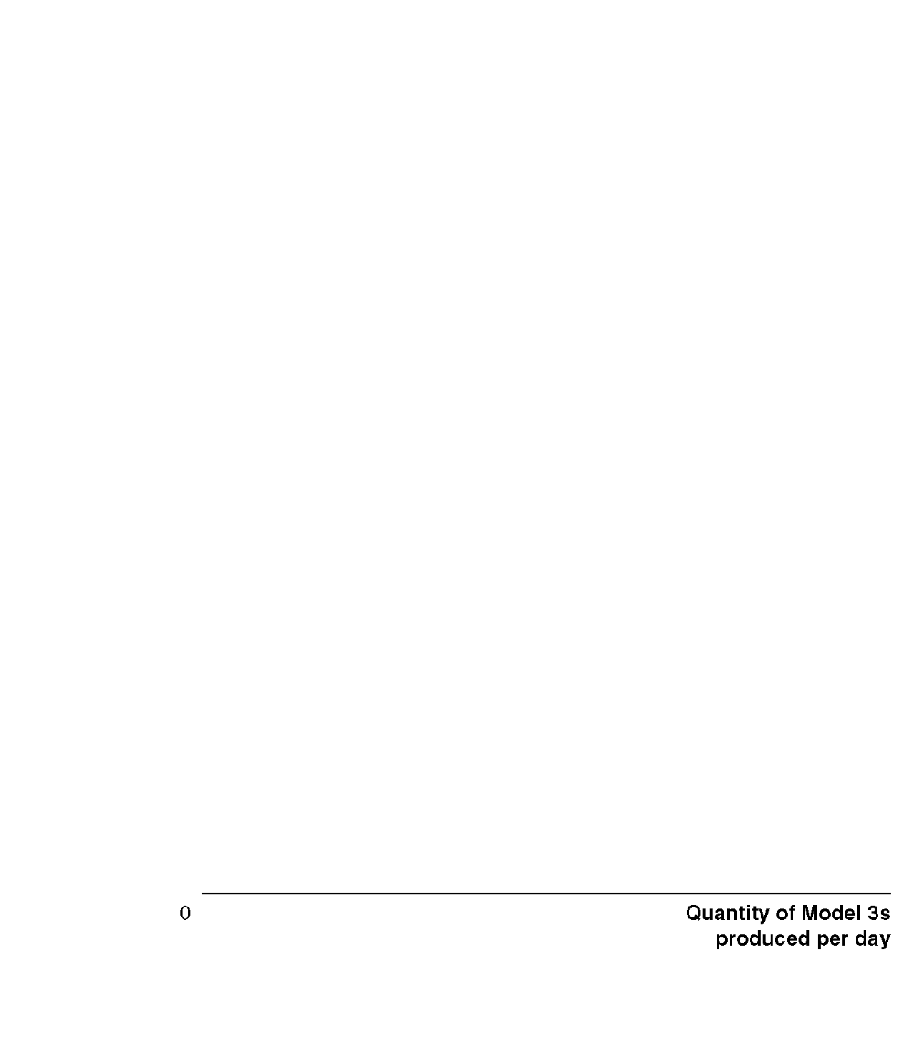
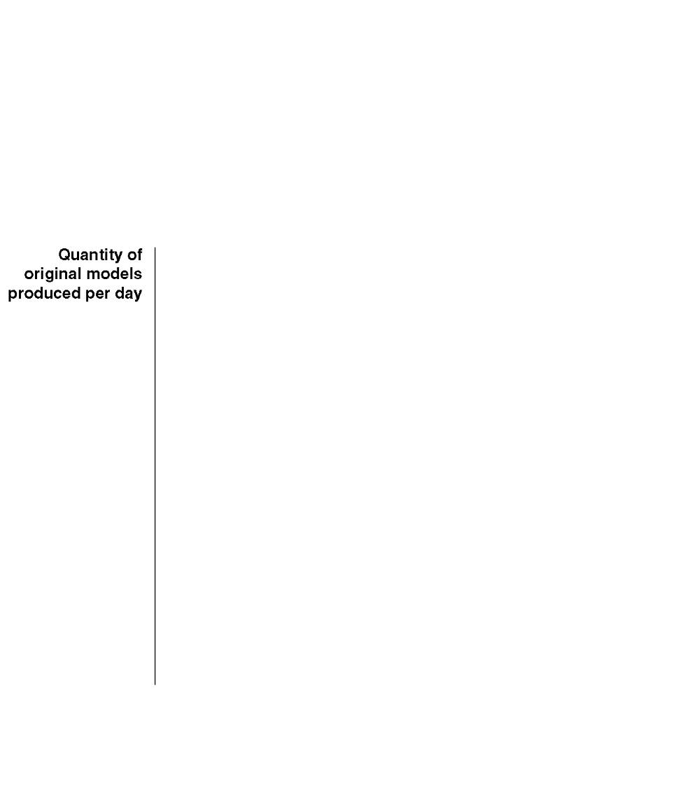



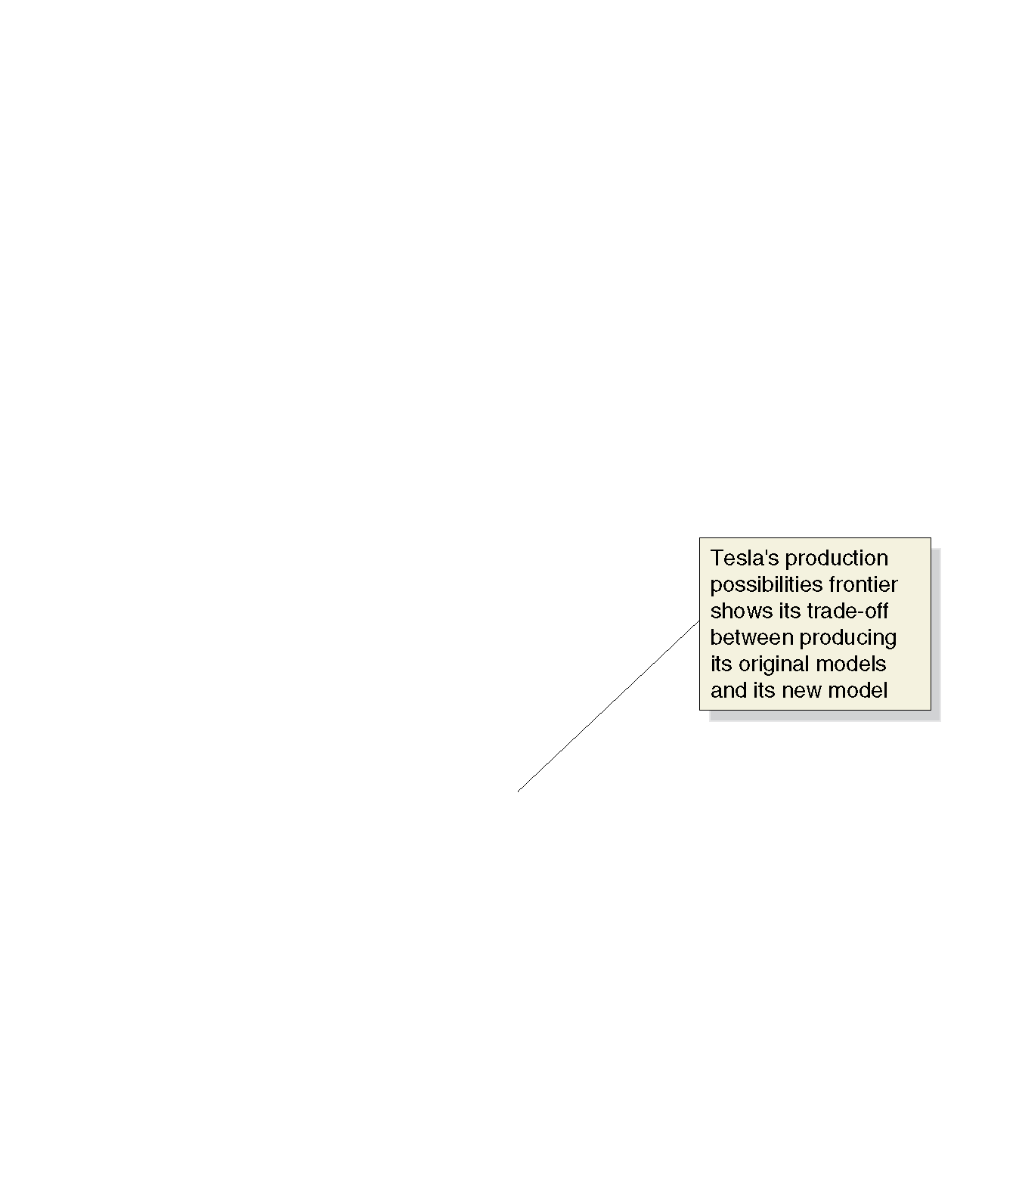
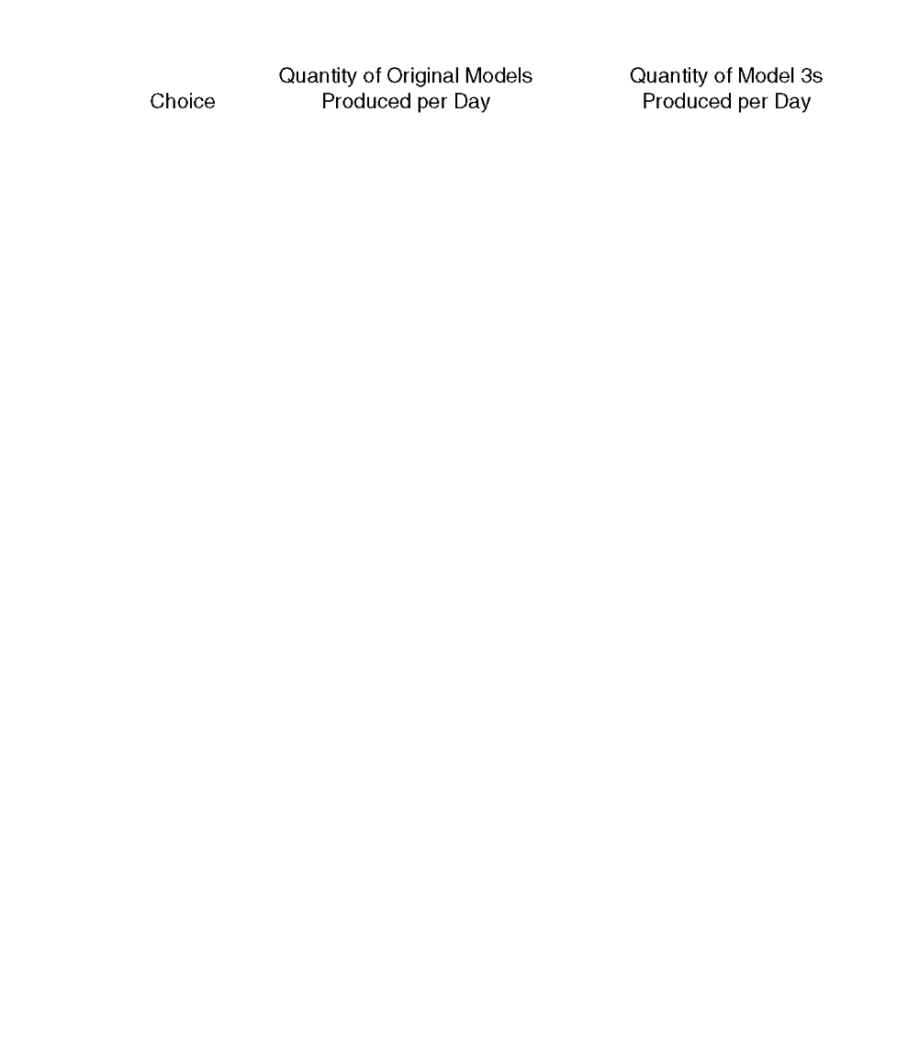



















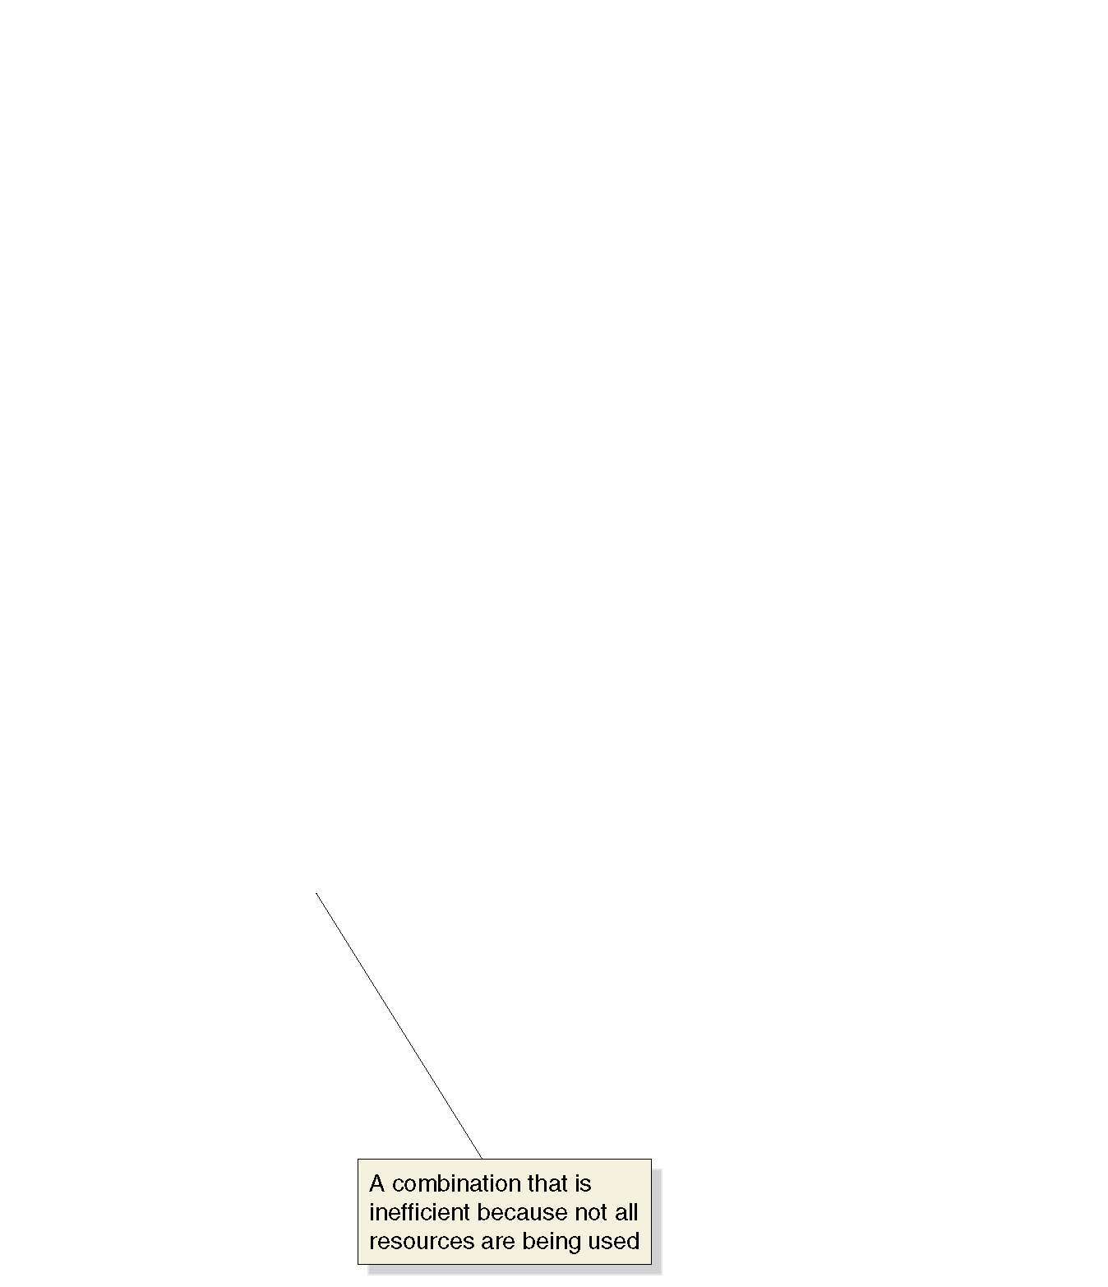




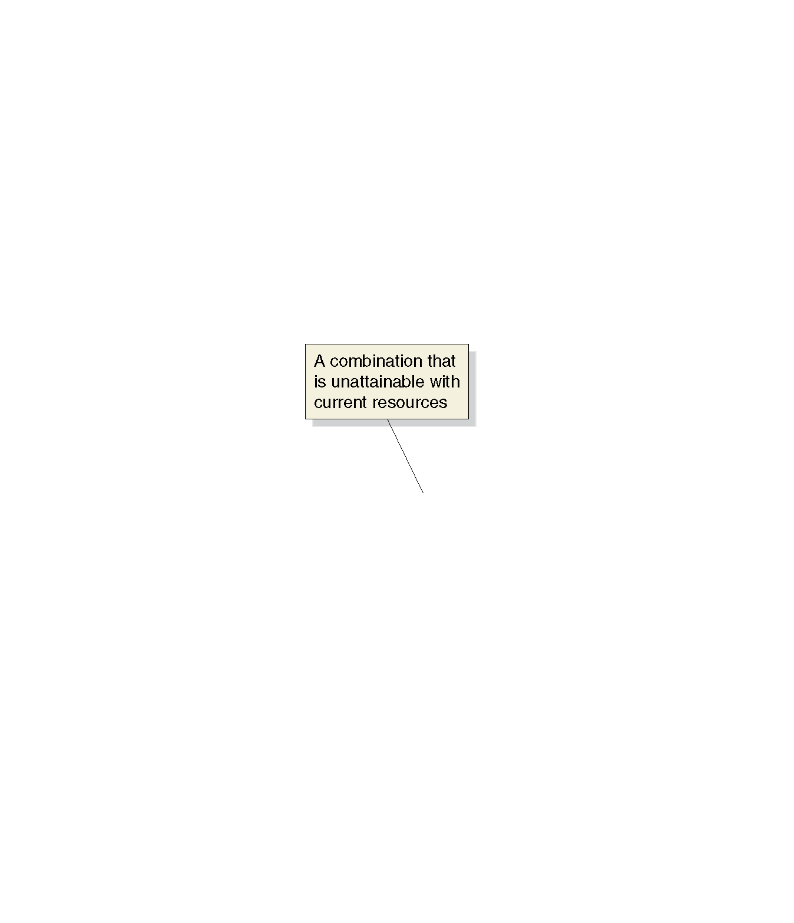
Figure 2.1 Tesla’s Production Possibilities Frontier (1 of 2)
Tesla can produce its original models, or its new Model 3s.
Producing more Model 3s requires reducing the number of original models produced.
Points on the PPF are attainable for Tesla.
Points below the curve are inefficient.
Points above the curve are unattainable with current resources.

Slide 6
Figure 2.1 Tesla’s Production Possibilities Frontier (2 of 2)
To produce 20 more Model 3s (e.g. moving from A to B), Tesla must produce 20 fewer original models.
The 20 fewer original models is the opportunity cost of producing 20 more Model 3s.
Opportunity cost: The highest-valued alternative that must be given up to engage in an activity.

Slide 7
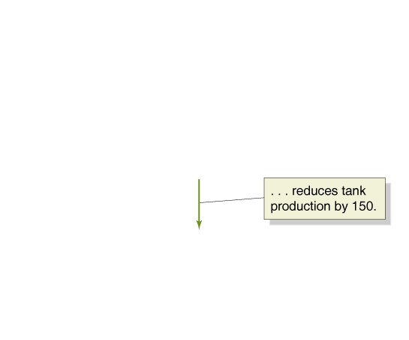
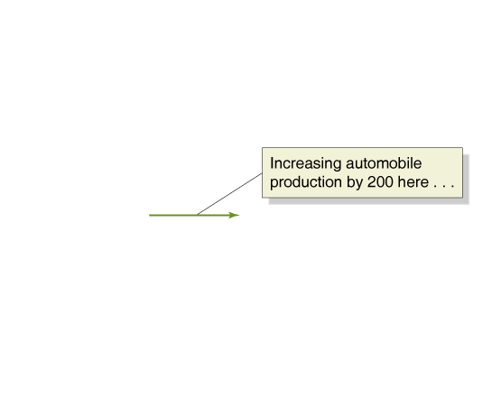
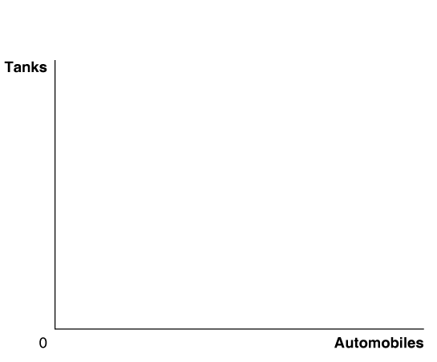
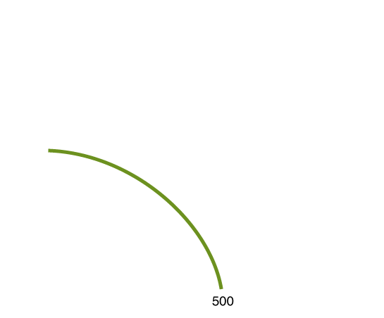
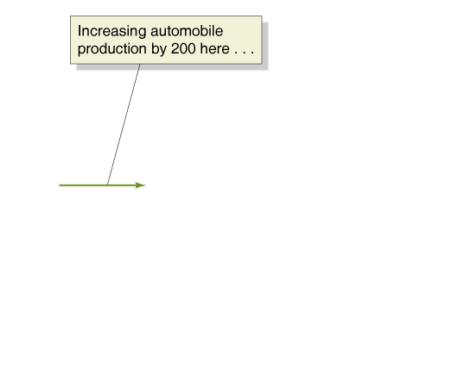

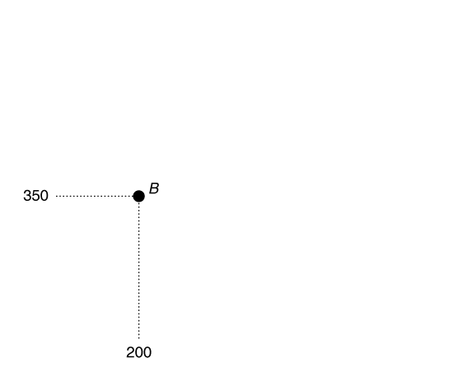
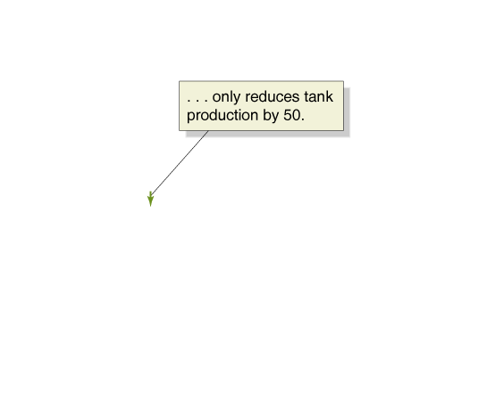
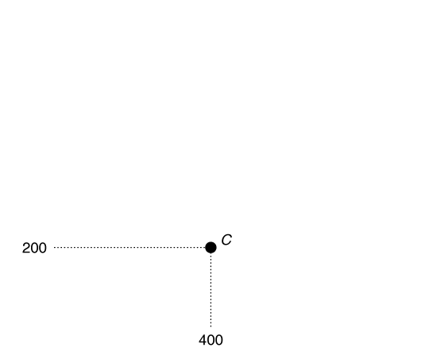
Figure 2.2 Increasing Marginal Opportunity Costs
On the previous slide, opportunity costs were constant.
But opportunity costs are often increasing.
Why? Some resources are better suited to one task than another. The first resources to “switch” are the one best suited to switching.
The more resources already devoted to an activity, the smaller the payoff to devoting additional resources to that activity.

Slide 8
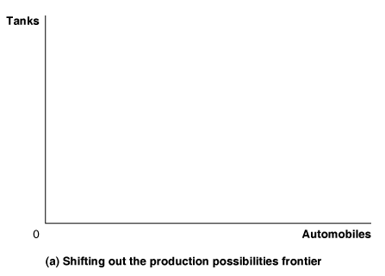
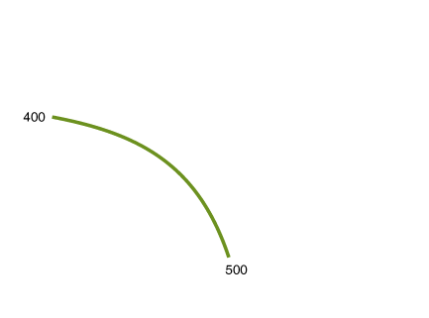
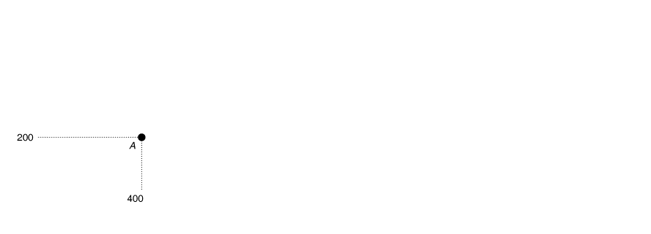
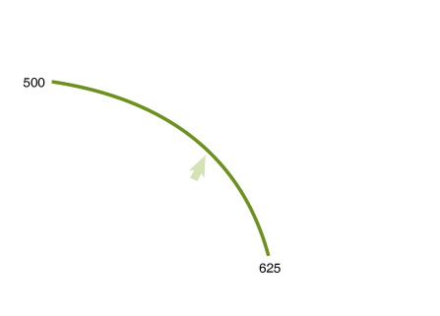
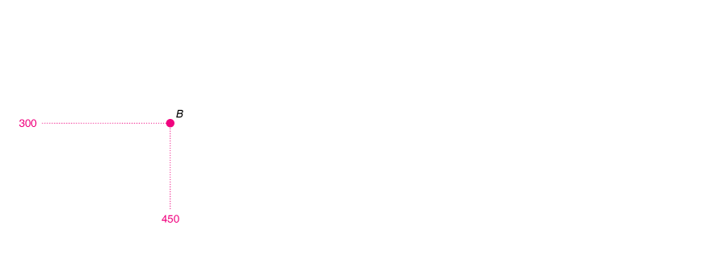


Figure 2.3 Economic Growth (panel (a))
As more economic resources become available, the economy can move from point A to point B, producing more tanks and more automobiles.
Shifts in the production possibilities frontier represent economic growth.
Economic growth: the ability of the economy to increase the production of goods and services.
Notes:
Panel (a) shows that as more economic resources become available and technological
change occurs, the economy can move from point A to point B, producing more
tanks and more automobiles.

Slide 9
2.2 Comparative Advantage and Trade
Describe comparative advantage and explain how it serves as the basis for trade.
You and your neighbor each have a limited time to pick apples and/or cherries.
The table shows the amount of each fruit that you could each pick, by devoting all of your time to that fruit.
Blank | You | Blank | Your Neighbor | Blank
Blank | Apples | Cherries | Apples | Cherries
Devote all time to picking apples | 20 pounds | 0 pounds | 30 pounds | 0 pounds
Devote all time to picking cherries | 0 pounds | 20 pounds | 0 pounds | 60 pounds

Slide 10
Specialization and Trade
What if you and your neighbor decided to specialize and trade?
Trade: The act of buying and selling.
Could your neighbor benefit from trade? She is better at picking both apples and cherries…
Both of you can benefit from trade, by specializing in what you are relatively good at. Let’s see how…

Slide 11
Explaining the Gains from Specialization and Trade
How could both of you benefit from trade, when your neighbor was so much better than you?
Economists say your neighbor had an absolute advantage in both cherry and apple picking, but you had a comparative advantage in picking apples.
Absolute advantage: The ability of an individual, a firm, or a country to produce more of a good or service than competitors, using the same amount of resources.
Comparative advantage: The ability of an individual, a firm, or a country to produce a good or service at a lower opportunity cost than competitors.

Slide 12
Apply the Concept: Comparative Advantage and Housework
People living together have to divide up household chores.
Basic economic concepts like comparative advantage can provide useful insight in the division of labor.
Suppose Jack is faster than Jill at both cooking and laundry. However:
Jack is MUCH faster at preparing tasty meals, while
Jack is only a little faster at doing laundry
Jack’s comparative advantage is in cooking—to cook a tasty meal, he gives up the opportunity to perform less laundry than Jill—so he should specialize in this, while Jill specializes in laundry.

Slide 13
2.3 The Market System
Explain the basics of how a market system works.
A market is a group of buyers and sellers of a good or service, and the institution or arrangement by which they come together to trade.
Two key groups participate in the modern economy:
Households consist of individuals who provide the factors of production: labor, capital, natural resources, and other inputs used to make goods and services.
Households receive payments for these factors by selling them to firms in factor markets.
Firms supply goods and services to product markets; households buy these products from the firms.

Slide 14
The Four Factors of Production
Labor: all types of work, from the part-time labor of teenagers working at McDonald’s to the work of senior managers in large corporations.
Capital: physical capital, such as computers, office buildings, and machine tools, used to produce other goods.
Natural resources: land, water, oil, iron ore, and other raw materials (or “gifts of nature”) that are used in producing goods.
An entrepreneur is someone who operates a business. Entrepreneurial ability is the ability to bring together the other factors of production to successfully produce and sell goods and services.

Slide 15


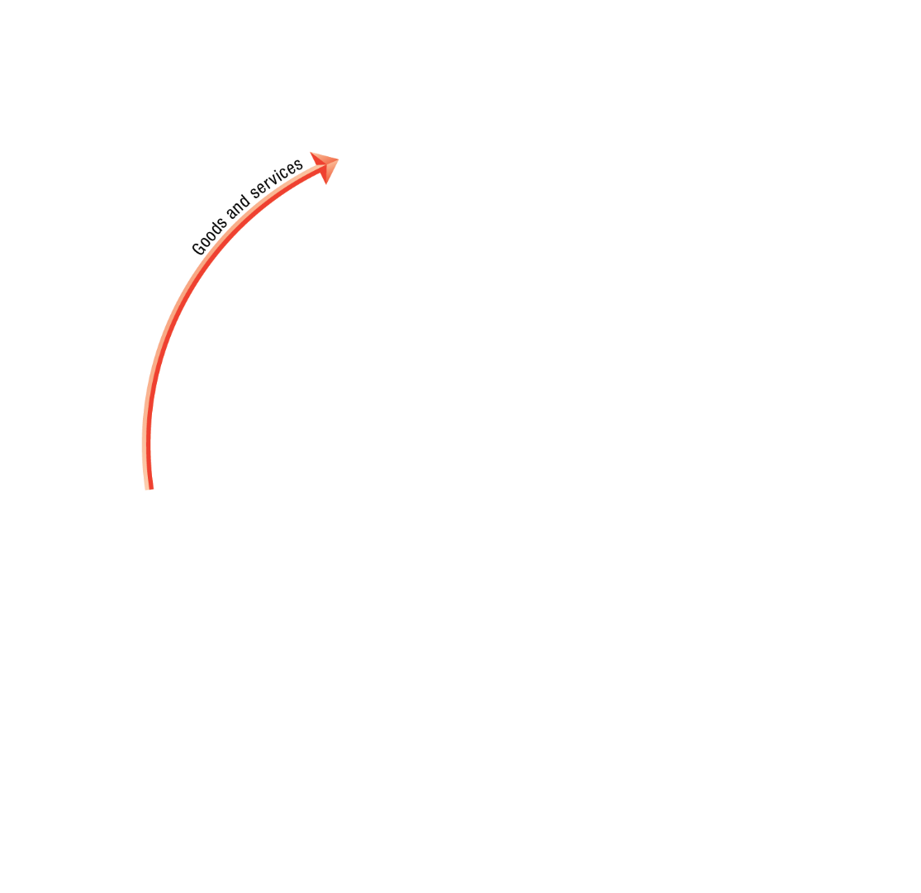
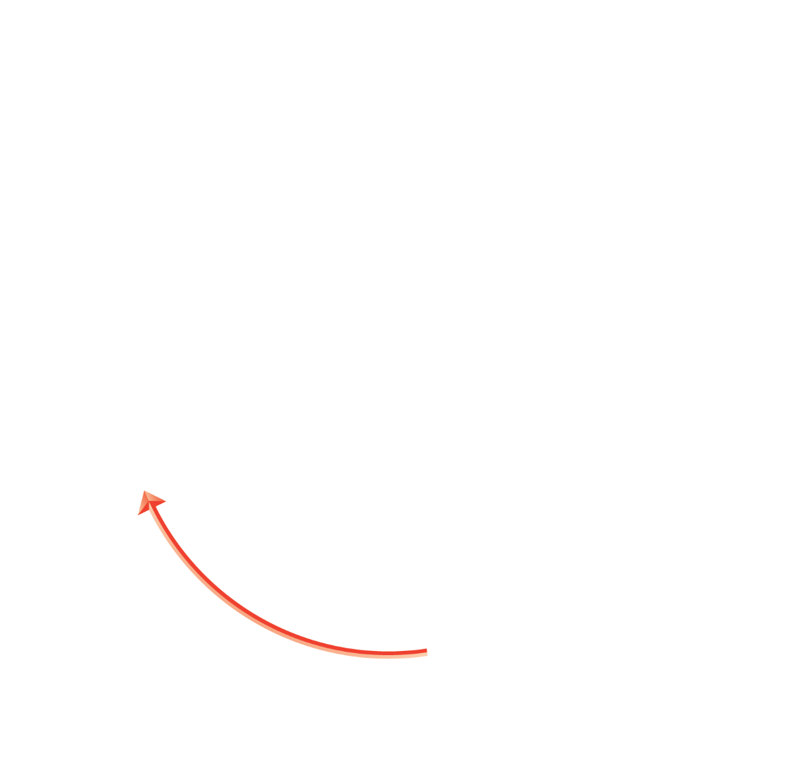
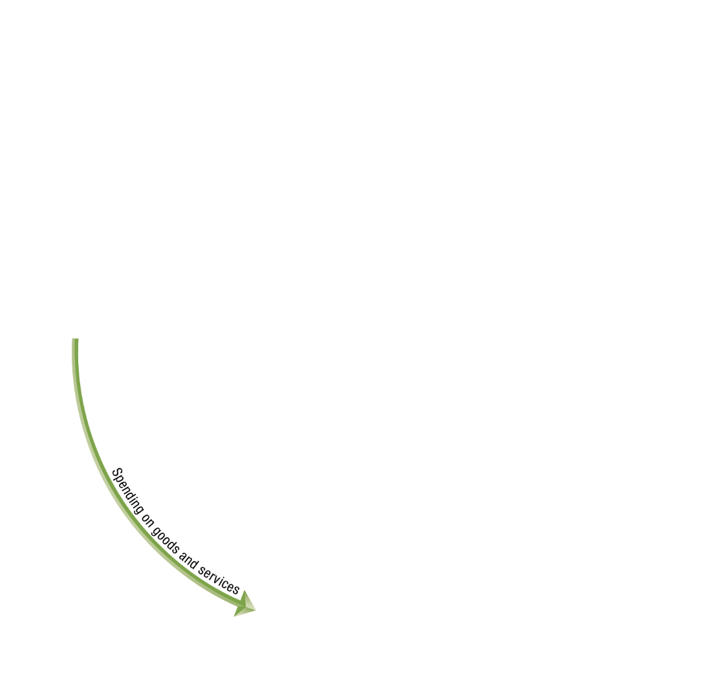







Figure 2.6 The Circular-Flow Diagram
Circular-flow diagram: A model that illustrates how participants in markets are linked.
Households provide factors of production to firms.
Firms provide goods and services to households.
Firms pay money to households for the factors of production.
Households pay money to firms for the goods and services.

Slide 16
The Gains from Free Markets
A free market is one with few government restrictions on how a good or service can be produced or sold or on how a factor of production can be employed.
Countries that come closest to the free market benchmark have been more successful than those with centrally planned economies in providing their people with rising living standards.
This concept is not new: Adam Smith argued for free markets in his 1776 treatise, An Inquiry into the Nature and Causes of the Wealth of Nations.

Slide 17
The Beauty of the Market Mechanism
It is not immediately obvious that markets will do better than centrally-planned systems for satisfying human desires.
After all, individuals are acting only in their own rational self-interest.
But markets with flexible prices allow the collective actions of households and firms to signal the relative worth of goods and services.
In this way, the “invisible hand” allows individual responses to collectively end up satisfying the wants of consumers.

Slide 18
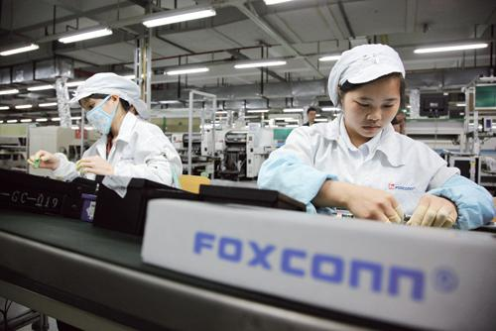
Apply the Concept: How Do You Make an iPad?
How do you make an iPad?
Although Apple engineers designed the iPad, Apple does not manufacture iPad components, nor does it assemble the final product.
Hundreds of firms are involved; many probably don’t even know their products will be used in an iPad.
But guided by their own self-interest, they all contribute to the final product—without any desire to enrich Apple or provide enjoyment for iPad purchasers.

Slide 19
The Role of the Entrepreneur in the Market System
An entrepreneur is someone who operates a business, bringing together the factors of production—labor, capital, and natural resources—to produce goods and services.
The best entrepreneurs create products that consumers never even knew they wanted.
“If I had asked my customers what they wanted, they would have said a faster horse.”
- Henry Ford
Entrepreneurs make a vital contribution to economic growth, often with considerable personal risk and sacrifice.

Slide 20
The Legal Basis of a Successful Market System
In a free market, government does not restrict how firms produce and sell goods, or how they employ factors of production.
However governments must provide a sound legal environment that will allow the market system to succeed, including:
Protection of private property
When criminals can take your wages or profits, households and firms have little incentive to work hard.
Property rights: the rights individuals or firms have to the exclusive use of their property, including the right to buy or sell it.
Enforcement of contracts and property rights
Important for transactions across time to occur.
An independent court system is critical for this.

Slide 21

Copyright

